Slide 1
YOLO v1, YOLO v2, YOLO v3, YOLO v4
Presented : Muhammad Zaqeem

Slide 2
Overview
Yolo v1
How Yolo v1 Work
Architecture of Yolo v1
Yolo v2

Slide 3
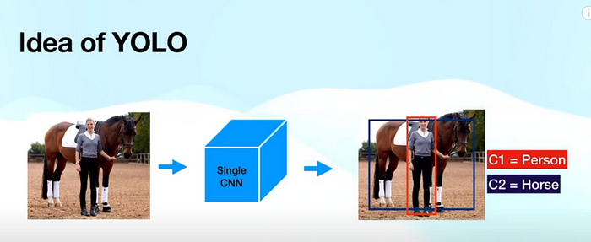
YOLO v1
YOLO v1 is a real-time object detection algorithm introduced by Joseph Redmon et al. in 2015.
YOLO v1 is an extremely fast object detection technique that processes images in real-time at 45 frames per second.
A single convolutional network simultaneously predicts multiple bounding boxes and class probabilities for those boxes.
Unlike earlier methods (e.g., R-CNN), YOLO predicts bounding boxes and class labels in one step using a single neural network.
The image illustrates the YOLO object detection process, where a single CNN processes an entire image in one forward pass to detect objects. The model assigns bounding boxes and class labels (C1 = Person, C2 = Horse) to identified objects, making YOLO fast and efficient for real-time detection. Unlike traditional methods.

Slide 4
How YOLO v1 Work
1. Image Preprocessing:
The input image is resized to 448×448 pixels for uniform processing.
The image is then divided into an S × S grid (typically 7 × 7 in YOLO v1).
2. Grid Cell Responsibility:
Each grid cell is responsible for detecting an object if the object’s center falls within that cell.
3. Bounding Box Representation:
Each bounding box is represented using:
(center_x, center_y) → Center coordinates of the object.
(width, height) → Dimensions of the bounding box.
These values are normalized by dividing by the image width and height.

Slide 5
How YOLO v1 Work
4. Target Assignments for Training
Each grid cell predicts:
Two bounding boxes (Δx, Δy, Δw, Δh, c for each).
One confidence score (c) → Represents whether an object is present.
Class probabilities (p1, p2, …, p20 for Pascal VOC dataset).
If a grid cell does not contain an object, all values are set to zero.
5. Model Prediction Format
The model outputs a 7×7×30 tensor for Pascal VOC dataset:
(2 bounding boxes × 5 values) + 20 class probabilities = 30 values per grid cell.
After prediction, only the bounding box with the highest confidence score is kept.

Slide 6
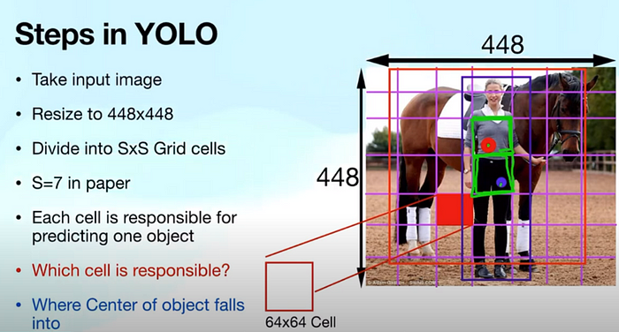
How YOLO v1 Work
6. Loss Calculation and Training:
The model’s predictions are compared against target values to compute loss.
Loss components:
Localization Loss → Measures accuracy of bounding box coordinates.
Confidence Loss → Determines object presence correctness.
Classification Loss → Evaluates class prediction accuracy.
The image explains the steps in YOLO (You Only Look Once) object detection. The input image is resized to 448×448 and divided into an S×S grid (S=7 in the original paper). Each grid cell is responsible for predicting one object, and the cell that contains the center of an object (marked in red) is assigned the task of making predictions for that object.

Slide 7
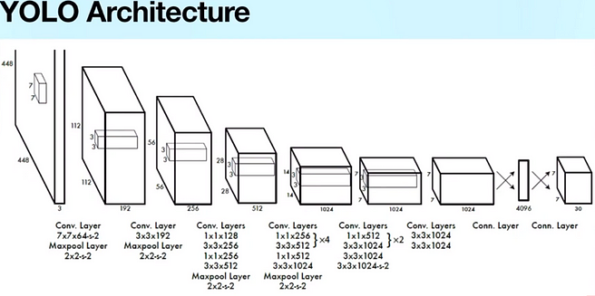
Architecture of YOLO v1
The YOLO (You Only Look Once) architecture is a CNN designed for real-time object detection. It processes a 448x448x3 input image through multiple convolutional layers, extracting features while reducing spatial dimensions using max-pooling. Early layers use large 7x7 and 3x3 filters, while later layers employ 1x1 convolutions for dimensionality reduction. The network deepens with increasing filter sizes, culminating in fully connected layers. The final output is a 7x7x30 tensor encoding bounding boxes, confidence scores, and class probabilities, enabling YOLO to detect multiple objects in a single forward pass efficiently.

Slide 8
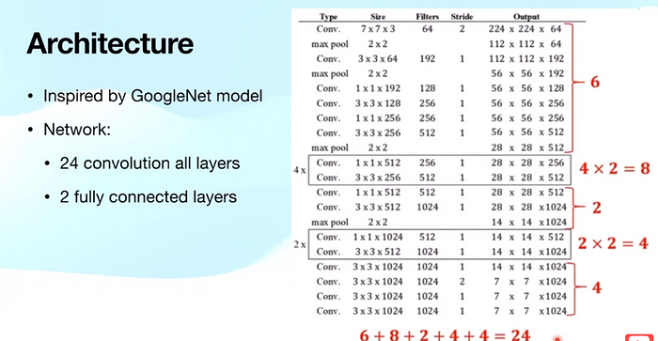
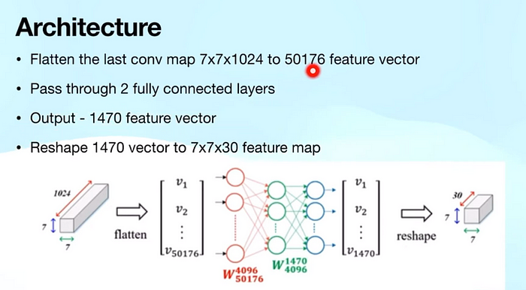
Architecture of YOLO v1
The architecture, inspired by GoogleNet, is a deep CNN with 24 convolutional layers for feature extraction and 2 fully connected layers for classification. It follows a structured approach, using 7×7 convolutions with max pooling early on to reduce spatial dimensions while preserving features. Deeper layers utilize 1×1 and 3×3 convolutions for finer feature extraction, contributing to the 24 convolutions (6 + 8 + 2 + 4 + 4 = 24). This hierarchical design ensures effective pattern learning for robust classification.
After convolutional processing, the final 7×7×1024 feature map is flattened into a 50176-dimensional feature vector. This vector is then passed through two fully connected layers, reducing it to a 1470-dimensional output. The final step reshapes this vector into a 7×7×30 feature map, which represents the final classification output. This structured approach ensures effective feature extraction, transformation, and classification.

Slide 10
Thank You

